Slide 1
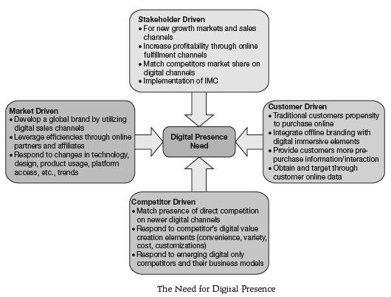
Digital Marketing Objectives Planning

Slide 2
Stakeholder-driven needs: It includes factors which are business/stakeholder-driven which necessitates a firm to move its product portfolio online.
Market-driven needs: As discussed in the last part on ‘External Analysis’ components, the external or market environment has a huge role to play in driving firms online

Slide 3
Customer-driven needs: The most immediate and relevant trends driving brands online are posed by customers themselves in the way their consumption patterns evolve.
Competitor-driven needs: Finally, it is competition too which drives brands to move towards digital channels.

Slide 4
Digital Presence Analysis Matrix
Key Competitive Comparision Factors
• Digital market share
• Digital channels presence
• Quality of web properties
• Digital sales
• Channel profitability
• Total digital customers
• Digital partner Tie-ups

Slide 5
• Daily purchases
• Social media followers
• Daily social mentions
• Comparision sites and analyst reviews
• Digital marketing spend Rol
• Brand perception and engagement
• Brand sentiment analysis
• Online value proposition
• Core competency analysis

Slide 6
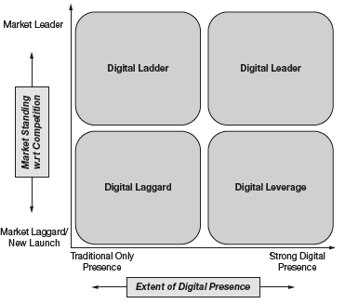
Digital Presence Analysis Matrix

Slide 7
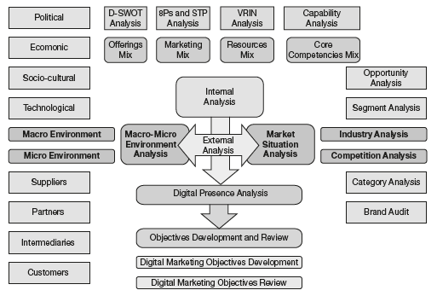
Digital Marketing Objectives Development

Slide 8
SMART Objectives Creation
Specific: Targets a specific area for improvement
Measurable: Quantifies or at least suggest an indicator for progress
Assignable: Specifies who will do it
Realistic: States what results can realistically be achieved, given the available resources
Time-related: Specifies when the results can be achieved

Slide 9
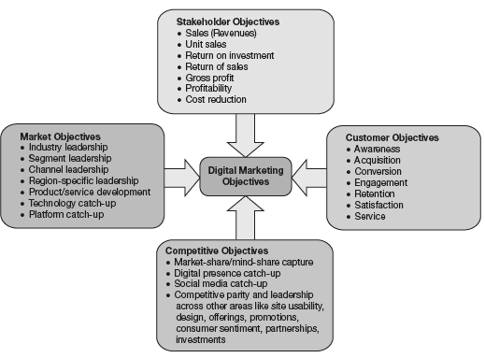
Types of Digital Marketing Objectives

Slide 10
Digital Marketing Objectives Review
Annual plan control
Profitability control
Efficiency control
Strategic control

